Slide 1


Slide 2
SECURE FILE SHARING WITH A REAL-WORLD APPLICATION
MINOR-2 Presentation
Guided by:
Mr. Amar Shukla (Senior Scale)
Assistant Professor
Department of Virtualization
School of Computer Science
Presented by:
Harsh Upadhyay, R110218060, CSE CCVT
Jayant Kochar, R110218074, CSE CCVT
Atul Garg, R110218037, CSE CCVT
Divyansh Thakur, R110218052, CSE CCVT

Slide 3
1. Introduction
In today’s era cloud computing is employed in almost every field like industry, military, college, etc. for storing huge amount of data and various other services offered by cloud computing.
This data can be easily accessed or retrieved on the users request without direct access to the main server computer, but the main concern here is the security of data stored online on the cloud.
In order to address this, we propose a system to safeguard this data stored online using a combination of AES and RSA algorithms.
Cryptography is the technique of protection of data from the unauthorized party by converting it into the non-readable form.
The main purpose of cryptography is maintaining the security of the data from any unauthorized access by any third party.
This can be achieved by using a combination of AES and RSA hybrid cryptographic algorithm.

Slide 4

2. Problem Statement
Data integrity has always been the utmost priority for every business besides which many a times data gets compromised.
Many-a-times companies get caught in a trapped state, not because of brute force attack but due to phishing and social engineering where sensitive information gets compromised by the employee unknowingly just by clicking on some malicious link or become a victim of a trapdoor virus.
Encryption will help eliminate this issues, as it protects individuals and organizations from the security nightmares of identity theft, cyber-fraud and the hefty price of data being lost or stolen or ransomed off.
[12] Fig. 1

Slide 5
3. Motivation
There are many users storing their data on cloud and various online locations, so the integrity of that data is a major concern.
The occurrences of data breaches are increasing day-by-day, and they are very hazardous for the user data.
This project tries to encrypt a file using AES and RSA to make it more immune to data breaches and more suitable for storing online.
The main motive of this project is to learn and understand different cryptographic algorithms and practice the Object Oriented concepts.

Slide 6
4. Objectives
The objective of this project include:
Learning and analysing different encryption algorithms
Implementing the hybrid cryptography algorithm including AES and RSA
Designing a file securing software to secure data and encrypting the file
Saving the file successfully on the desired cloud platform
Decrypting the file for use whenever required.

Slide 7
5. Software/ Hardware Requirements
Hardware Interface
64 bits processor architecture.
The minimum RAM requirement for proper functioning is 2 GB.
Required input as well as output devices.
Intel Dual Core or Higher Processor.
Software Interface
This system is developed in the Java programming language.
Any operating system
NetBeans IDE

Slide 8
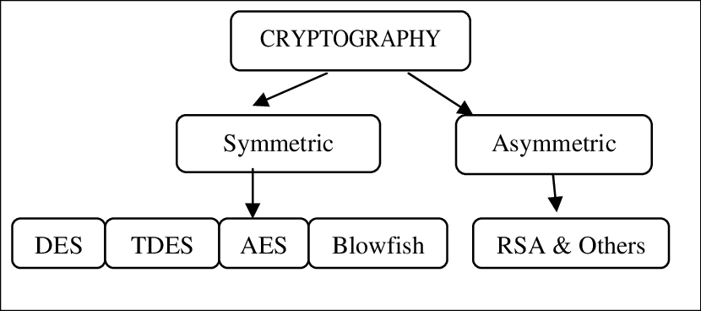
6. Cryptography
It is the science and art of making data secure and immune to attacks.
Cryptography is the technique of protection of data from the unauthorized party by converting it into the non-readable form.
The main purpose of cryptography is maintaining the security of the data from any unauthorized access by any malicious user.
[8] Fig. 2Classification of Cryptography

Slide 9
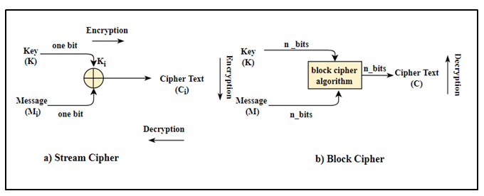
7. Symmetric Key Algorithm
Also referred to as conventional key algorithm
Only one key (a secret key) is used for both encrypting and decrypting the electronic information or data.
Symmetric algorithm can be additionally separated into two types:
Block algorithms.
Stream algorithms.
[8] Fig. 3 Symmetric Key Encryption
[8] Fig. 4 Block and Stream Encryption

Slide 10
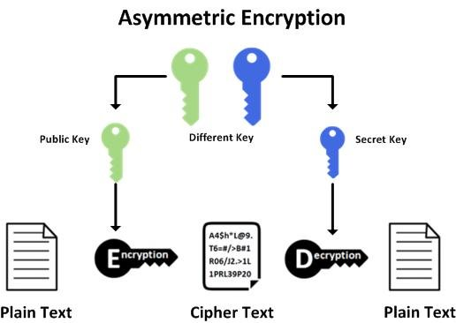
8. Asymmetric Key Algorithm
Under which plain text is combined with a key as a input to an algorithm, and output is ciphertext.
The key pair comprises of a private key and a public key.
Which key is going to be used for encryption and decryption varies depending on the intended use of asymmetric-key algorithm.
[6] Fig. 5 Asymmetric Key Encryption

Slide 11
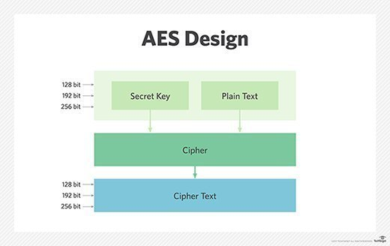
9. Methodology
AES is the abbreviation of Advanced Encryption Standard.
It is approved by the US NIST in 2001.
Here symmetric cryptography algorithm AES is used for encryption while using RSA for encrypting the AES secret key itself.
It’s a standard algorithm which is used for the encryption and decryption of the file.
It is more secure as comparative to DES I.e. Data Encryption Standard or 3-DES.
[6] Fig. 6 AES Encryption

Slide 12
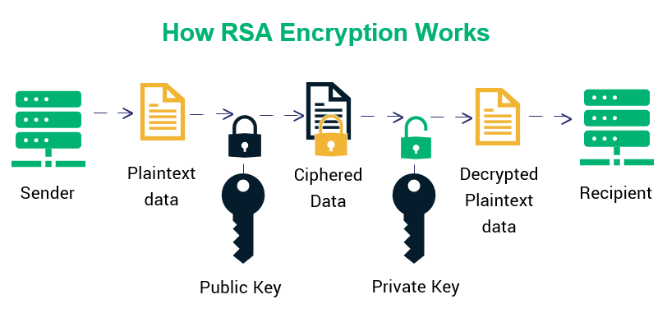
9. Methodology
It stands for Rivest–Shamir–Adleman algorithm.
It's a public key cryptosystem that is widely used for secure data transmission.
It's an asymmetric cryptographic algorithm, I.e. there are two keys that that is public and private key to encrypt and decrypt the data.
We can share public key to anyone or with that one with which we can share our encrypted file to decrypt that file using that public key.
Private key is used for encrypting the file and this key should not be shared with anyone as this is private.
[6] Fig. 7 RSA Encryption

Slide 13
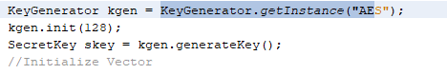
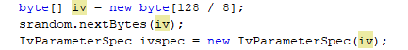
10. Implementation
10.1 Generating the AES Key:-
Here we are generating the AES key, which is used here for the encryption.
We are generating the key of size 128 bits.
Here we also need to generate the initialization vector (IV).
The needs to be communicated to decrypt the message to the receiver.
The IV length here is usually comparable to the length of the encrypted key
Fig. 8 AES Key Generation
Fig. 9 Initialization Vector

Slide 14
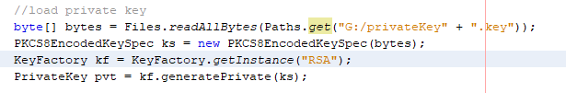
10. Implementation
10.2 Loading the RSA Private key:-
Here, the previously generated RSA private key is loaded from file.
Fig. 10 Loading the RSA private key

Slide 15
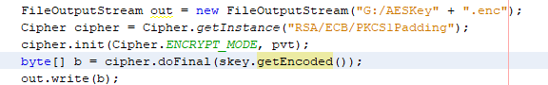
10. Implementation
10.3 Save the AES Key :-
The first part of the output contains the AES key which is encrypted.
So for encryption, cipher class with RSA’s private key is used and saved.
The cipher here is the one that actually handles the encryption and decryption. It needs the symmetric key and also needs the Initialization vector.
Fig. 11 Save AES key

Slide 16

10. Implementation
10.4 Write the Initialization Vector:-
This is required for the decryption using AES key
It needs to be communicated to decrypt the message to the receiver.
Fig. 12 Write the Initialization Vector

Slide 17
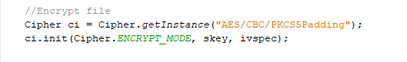
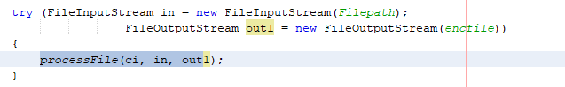
10. Implementation
10.5 Encrypting the File Contents using the AES Key:-
So now, it’s the final step, in this we have to encrypt the contents of our file.
Then we write it on the output file.
Fig. 13 Encrypting the file

Slide 18
10. Implementation
10.6 Decrypting the file using RSA public key:-
Here, read the input data in a loop and then invoke cipher. Update. So, if a byte array is returned, then we can write it to the output file.
Now since the private key was used for encryption, the public key can be used for decrypting contents of the file. The file includes AES key encrypted with RSA private key at the start followed by initialization vector(iv), and the encrypted file data itself. So, all these steps are handled by the decryption process in order to get at the file data.
Fig. 12 Encrypting the file

Slide 19
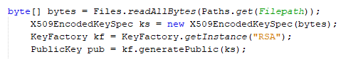
10. Implementation
10.7 Load the RSA Public Key from File:-
The RSA public key from a file is loaded using the following code from where it has been saved in binary format.
Fig. 12 Loading the RSA Public Key

Slide 20
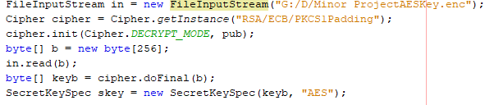
10. Implementation
10.8 Load the AES Secret Key:-
The encrypted file is then opened and the AES secret key is loaded. The AES secret key is being obtained from the above data by decrypting it using the RSA public key.
Fig. 12 Loading the AES Secret keye

Slide 21
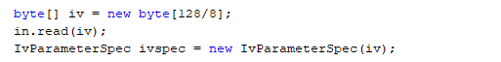
10. Implementation
10.9 Read the Initialization Vector:-
Next in the file is the initialization vector. Load it as follows:
Fig. 12 Read the Initialization Vector

Slide 22
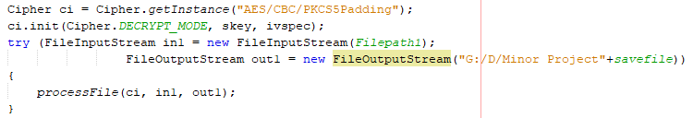
10. Implementation
10.10 Decrypt the File Contents:-
Here the final decryption of the file contents takes place with the help of AES secret key. The output obtained is then written in a file having extension (.ver) for verification purposes.
Fig. 12 Decrypting the File Contents

Slide 23
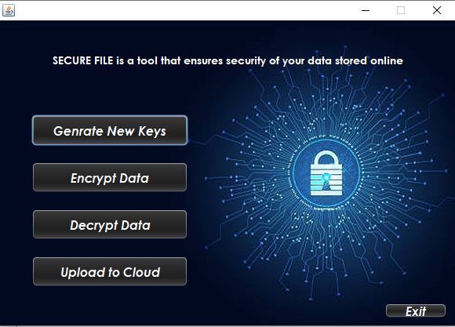
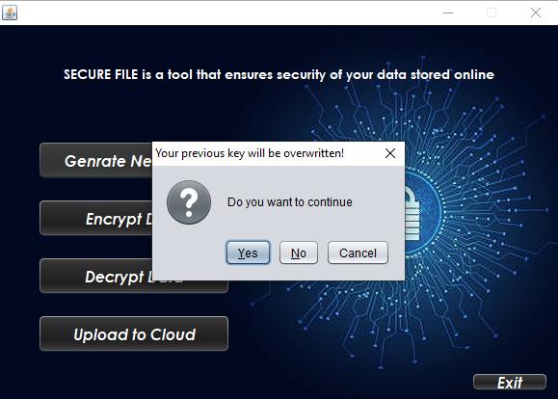
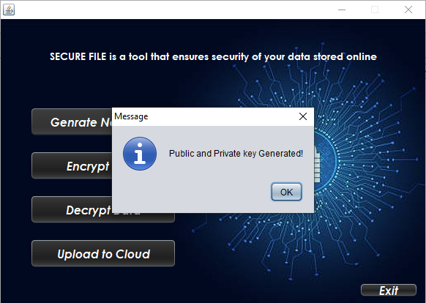
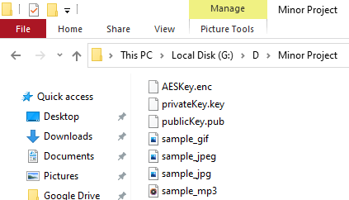
11. Project Screenshots
Fig.14 Home Screen
Fig.15 Key Generation
Fig.16 Keys Generated Successfully
Fig.17 Keys(in RED)

Slide 24
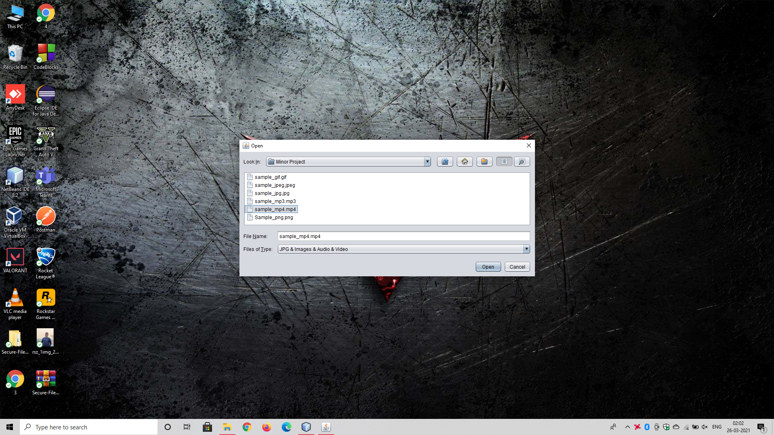
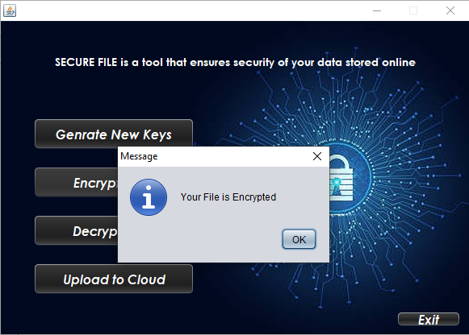
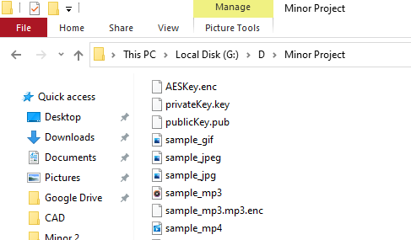
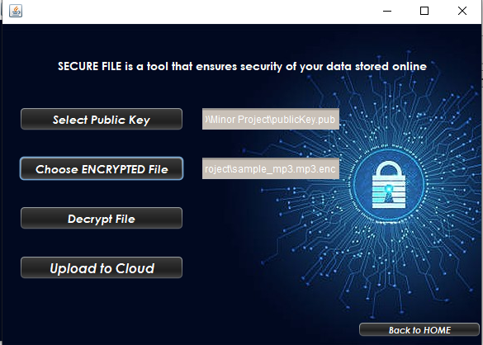
11. Project Screenshots
Format supported are:-
.jpg, .gif, .mp4, .mp3, .jpeg, .png
Fig.18 Choose File Dialog
Fig.19 File Encrypted successfully
Fig.20 Encrypted File (in RED)
Fig.21 Decrypt Data page

Slide 25
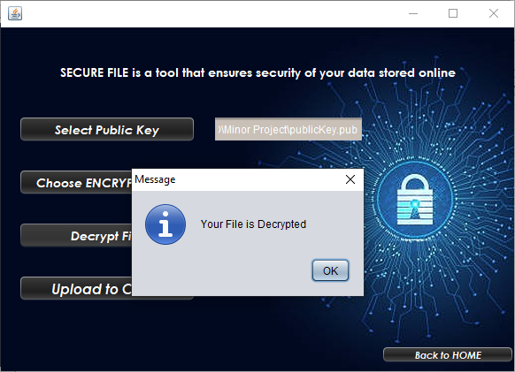
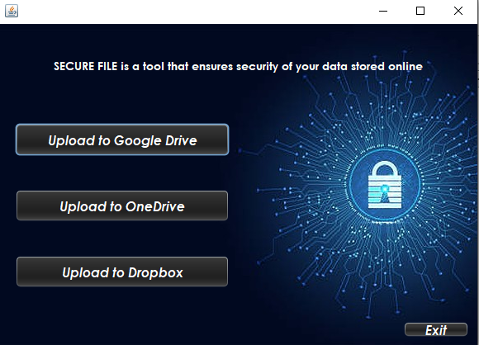
11. Project Screenshots
These buttons open the respective cloud provider’s web-page.
Fig.22 File Decrypted Successfully
Fig. 23 Upload to cloud page

Slide 26
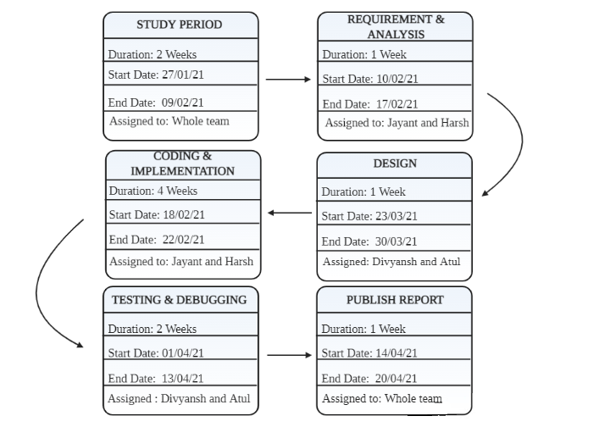
12. Pert Chart
Fig.24 Program Evaluation Review Technique Chart

Slide 27
13. Objectives covered
Objectives | Status
Requirement gathering | Completed
Implementing the Encryption part | Completed
Testing of the implemented algorithm | Completed
To implement the decryption part | Completed
Testing the implemented algorithm | Completed
To add connectivity to different cloud platform to store file online | Completed
Testing of the whole integrated system | Completed
Documenting the project | Completed

Slide 28
14. References
Agrawal, Monika & Mishra, Pradeep. (2012). A Comparative Survey on Symmetric Key Encryption Techniques. Int. J. Comput. Sci. Eng.. 4.
Binita Thakkar , Dr. Blessy Thankachan, 2020, A Survey for Comparative Analysis of various Cryptographic Algorithms used to Secure Data on Cloud, INTERNATIONAL JOURNAL OF ENGINEERING RESEARCH & TECHNOLOGY (IJERT) Volume 09, Issue 08 (August 2020),
Ahmad, Jasmin & Din, Roshidi & Ahmad, Mazida. (2018). Analysis Review on Public Key Cryptography Algorithms. Indonesian Journal of Electrical Engineering and Computer Science. 12. 447-454. 10.11591/ijeecs.v12.i2.pp447-454.
Perumal, Prakash. (2016). Enrichment of Mobile data Security over Cloud storage using New Asymmetric key algorithm.
Shenoy, Nagesh & Rao, Abhishek. (2020). Data Security in Cloud Environment Based on Comparative Performance Evaluation of Cryptographic Algorithms.
https://www.researchgate.net/figure/Asymmetric-encryption-primitive_fig2_321123382//www.researchgate.net/figure/Asymmetric-encryption-primitive_fig2_321123382
International Journal of Advanced Trends in Computer Science and Engineering. 9. 4989-4997. 10.30534/ijatcse/2020/115942020.
https://www.researchgate.net/publication/344151567_Data_Security_in_Cloud_Environment_Based_on_Comparative_Performance_Evaluation_of_Cryptographic_Algorithms (accessed on 3/2/21)
https://www.researchgate.net/figure/Classification-Of-Cryptography_fig1_266872600(accessed on 5/2/21)
https://sectigostore.com/blog/types-of-encryption-what-to-know-about-symmetric-vs-asymmetric-encryption/ (accessed on 14/2/21)
https://www.denimgroup.com/resources/blog/2013/10/asymmetric-symmetric-algorithms/ (accessed on 16/2/21)
https://www.precisely.com/blog/data-security/aes-vs-rsa-encryption-differences (accessed on 19/2/21)
https://www.google.com/search?q=computer+securitySecurity+image+with++light+background&tbm=isch&ved=2ahUKEwiz0NuVlczvAhWJ7nMBHUwXA80Q2-cCegQIABAA&oq=computer+securitySecurity+image+with++light+background&gs_lcp=CgNpbWcQA1CzJFiHRWDYR2gAcAB4AIABiAGIAa8VkgEEMC4yMpgBAKABAaoBC2d3cy13aXotaW1nwAEB&sclient=img&ei=vOJcYLOCF4ndz7sPzK6M6Aw&bih=937&biw=1920#imgrc=H68rcqhyYOD9TM

Slide 29
THANK YOU

